Slide 1


Learn DynamoDB and Become Expert in fun and Easy way 0 to hero with Labs
Soumil Shah
Soumil Shah | Shahsoumil519@gmail.com | Youtube Soumil shah | http://soumilshah.herokuapp.com/

Slide 2
About Myself
Soumil N Shah
Bachelor in Electronic Engineering
Master in Electrical Engineering
Masters in Computer Engineering
I earned a Bachelor of Science in Electronic Engineering and a double master’s in Electrical and Computer Engineering. I have extensive expertise in developing scalable and high-performance software applications in Python. I have a YouTube channel where I teach people about Data Science, Machine learning, Elastic search, and AWS. I work as data collection and processing Team Lead at Jobtarget where I spent most of my time developing Ingestion Framework and creating microservices and scalable architecture on AWS. I have worked with a massive amount of data which includes creating data lakes (1.2T) optimizing data lakes query by creating a partition and using the right file format and compression. I have also developed and worked on a streaming application for ingesting real-time streams data via kinesis and firehose to elastic search

Slide 3
Articles
A Journey for Semantics Search with Elastic Search (80M) vectors Search (1.4TB)
Article Link: https://www.linkedin.com/pulse/journey-semantics-search-elastic-80m-vectors-14tb-soumil-shah/
Event processing of data streams optimizing SQS processing and efficient end-user querying
Link https://www.linkedin.com/pulse/event-processing-data-streams-optimizing-sqs-efficient-soumil-shah/
Serverless Data Enrichment Pipeline using Step Functions for Sourcer Product (1000 Request/Second)
Link: https://www.linkedin.com/pulse/serverless-data-enrichment-pipeline-using-step-functions-soumil-shah/
Fully Automated Data Ingestion Pipeline (Ingest 1.2TB) To Elastic Search using AWS Step function and Lambda and Firehose
Link: https://www.linkedin.com/pulse/fully-automated-data-ingestion-pipeline-ingest-12tb-elastic-shah/

Slide 4
Articles
How we got 50X faster Speed for querying Data Lake using Athena Query & saved Thousands of dollars | Case Study
Link: https://www.linkedin.com/pulse/how-we-got-50x-faster-speed-querying-data-lake-using-athena-shah/
Robust Architecture to populate Data from MongoDB in Real-Time Using Mongo Streams, Event Bridge, SQS Queue, and Lambdas (Processing 20k Events Per Day
Link: https://www.linkedin.com/pulse/robust-architecture-populate-data-from-mongodb-real-time-soumil-shah/
Batch framework(An Internal Data Ingestion Framework that process 1TB of data in a Month and run 200+ Jobs)
Link: https://www.linkedin.com/pulse/batch-frameworkan-internal-data-ingestion-framework-process-shah/
Elastic Search Performance Tuning and Optimization How We Got 80X Faster Searches a Case Study
Link: https://www.linkedin.com/pulse/elastic-search-performance-tuning-optimization-how-we-soumil-shah/

Slide 5
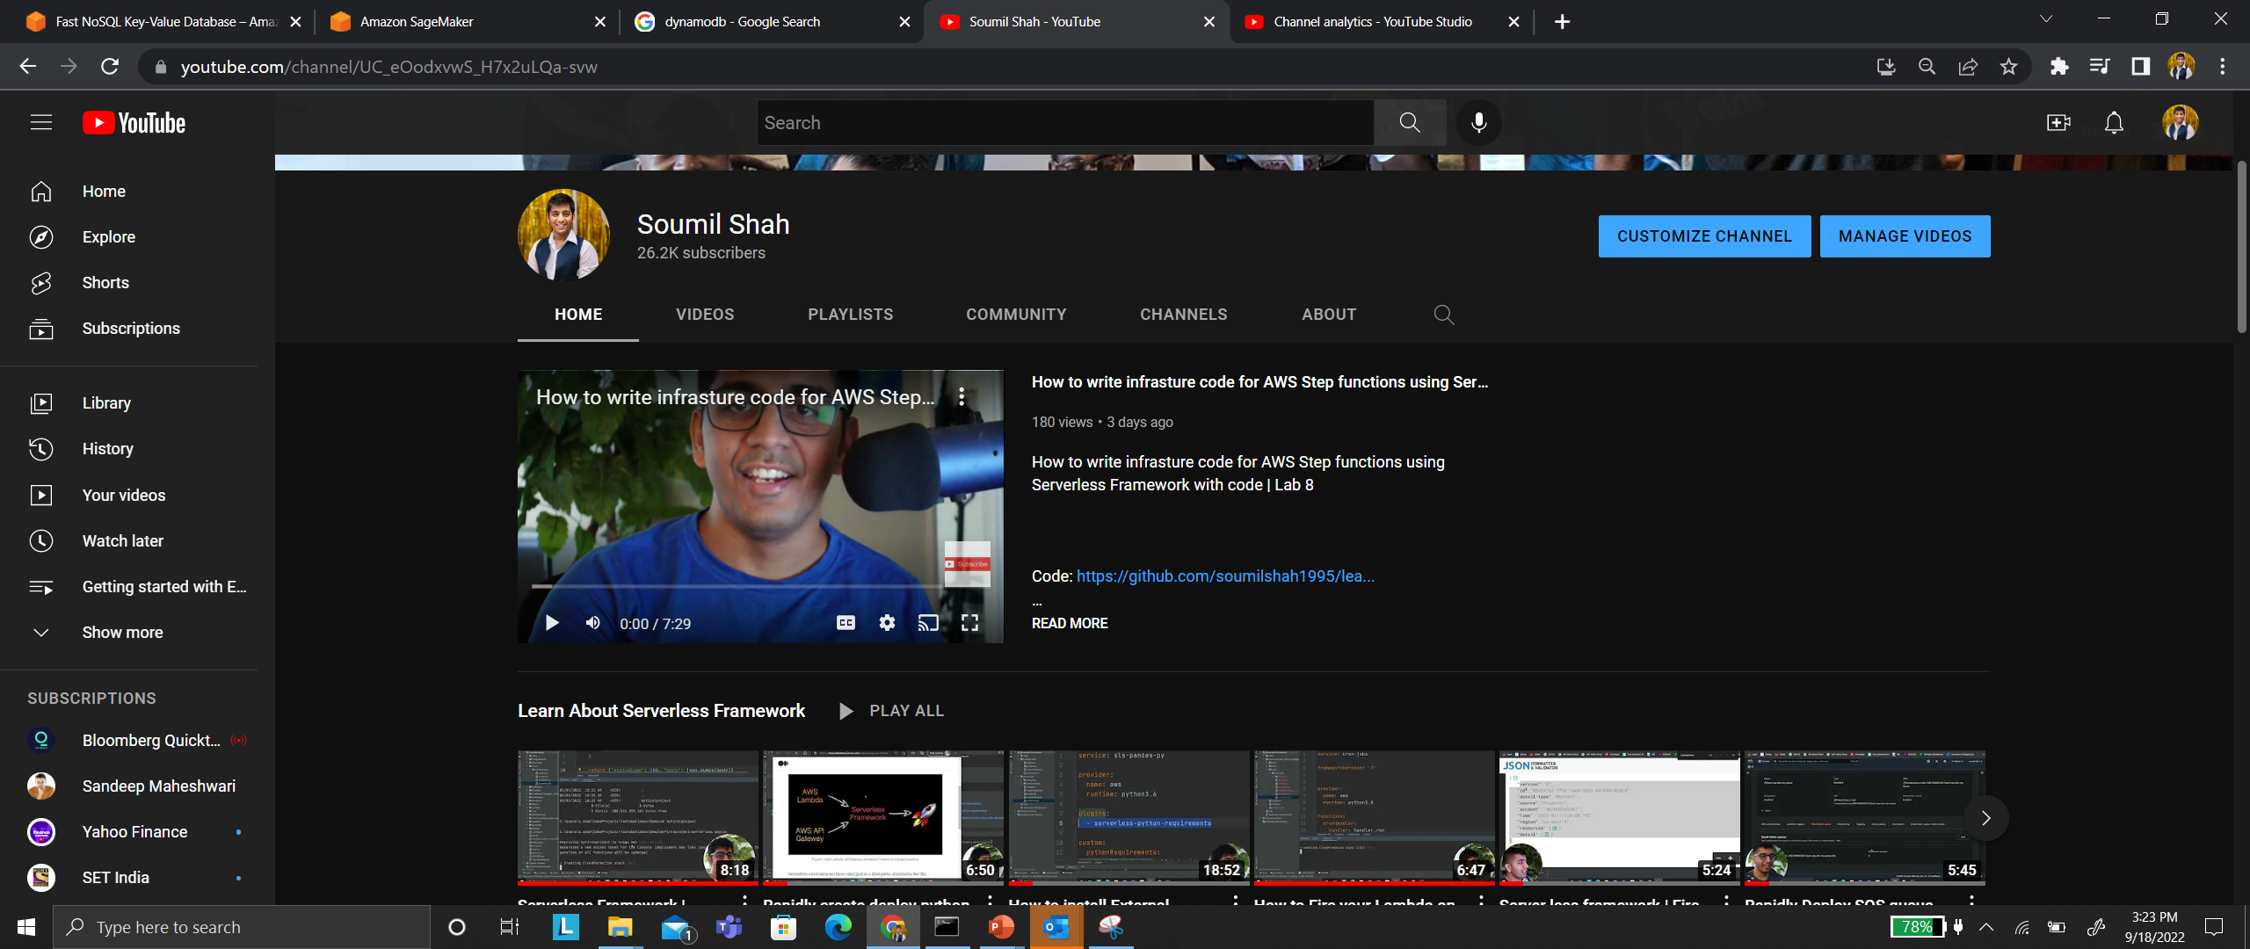
Youtuber

Slide 6
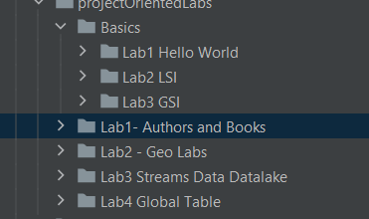
Contents
What is DynamoDB why its so trending ?
Supported Data Types
Scaling options
Partition keys
Global Secondary Index
Scans
Strong Consistency and Eventual Consistency
DynamoDB Streams

Slide 7
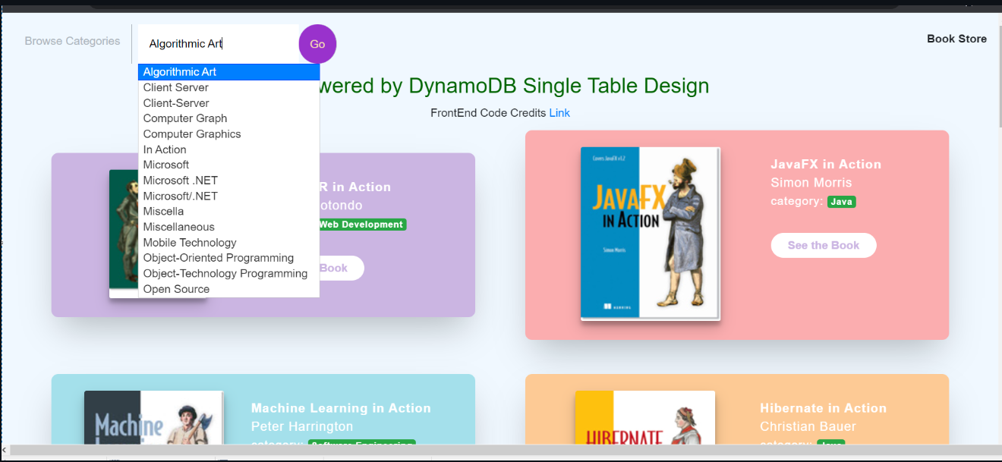
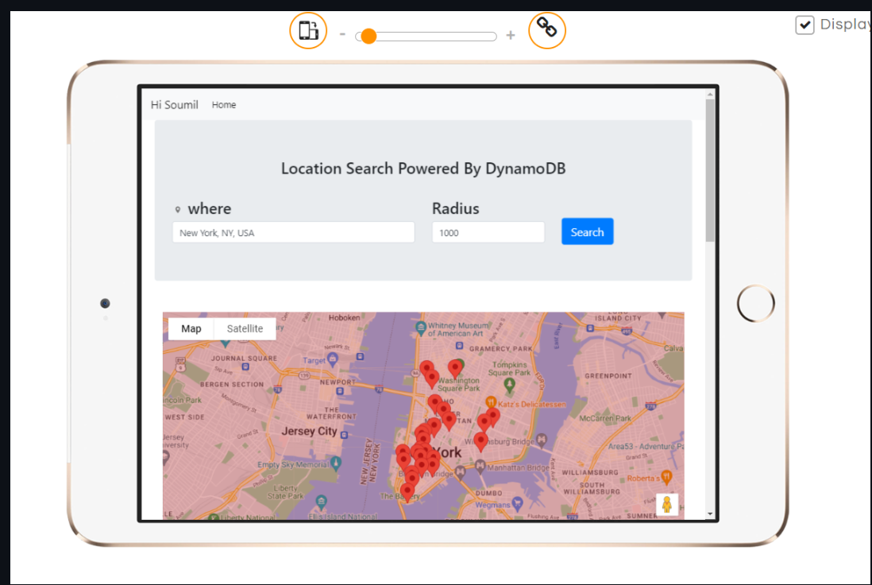
Contents
Labs
Basics
DynamoDB Hello World
GSI labs
LSI Labs
Project 1: Books Search System
Project 2: geo Search in DynamoDB
Create Data Archiving Architectures with DynamoDB Streams
Hands on Lab and Session on DynamoDB Global tables
Popular Interview Questions

Slide 8
What is DynamoDB ?
Amazon DynamoDB is a fully managed, serverless, key-value NoSQL database designed to run high-performance applications at any scale. DynamoDB offers built-in security, continuous backups, automated multi-Region replication, in-memory caching, and data import and export tools.
amazon. “Amazon.” Accessed September 18, 2022. https://aws.amazon.com/dynamodb/?trk=94bf4df1-96e1-4046-a020-b07a2be0d712&sc_channel=ps&s_kwcid=AL!4422!3!610000101513!e!!g!!dynamodb&ef_id=CjwKCAjwg5uZBhATEiwAhhRLHqPtUNDSySSNQD6ctcznaNsCjLMv1cPeLrdQ8vwNU2KHoIIgtJoUThoCEWkQAvD_BwE:G:s&s_kwcid=AL!4422!3!610000101513!e!!g!!dynamodb.

Slide 9
Use Cases
Develop software applications
Build internet-scale applications supporting user-content metadata and caches that require high concurrency and connections for millions of users and millions of requests per second.
Create media metadata stores
Scale throughput and concurrency for media and entertainment workloads such as real-time video streaming and interactive content, and deliver lower latency with multi-Region replication across AWS Regions.
amazon. “Amazon.” Accessed September 18, 2022. https://aws.amazon.com/dynamodb/?trk=94bf4df1-96e1-4046-a020-b07a2be0d712&sc_channel=ps&s_kwcid=AL!4422!3!610000101513!e!!g!!dynamodb&ef_id=CjwKCAjwg5uZBhATEiwAhhRLHqPtUNDSySSNQD6ctcznaNsCjLMv1cPeLrdQ8vwNU2KHoIIgtJoUThoCEWkQAvD_BwE:G:s&s_kwcid=AL!4422!3!610000101513!e!!g!!dynamodb.

Slide 10
Use Cases
Deliver seamless retail experiences
Use design patterns for deploying shopping carts, workflow engines, inventory tracking, and customer profiles. DynamoDB supports high-traffic, extreme-scaled events and can handle millions of queries per second.
Scale gaming platforms
Focus on driving innovation with no operational overhead. Build out your game platform with player data, session history, and leaderboards for millions of concurrent users.
amazon. “Amazon.” Accessed September 18, 2022. https://aws.amazon.com/dynamodb/?trk=94bf4df1-96e1-4046-a020-b07a2be0d712&sc_channel=ps&s_kwcid=AL!4422!3!610000101513!e!!g!!dynamodb&ef_id=CjwKCAjwg5uZBhATEiwAhhRLHqPtUNDSySSNQD6ctcznaNsCjLMv1cPeLrdQ8vwNU2KHoIIgtJoUThoCEWkQAvD_BwE:G:s&s_kwcid=AL!4422!3!610000101513!e!!g!!dynamodb.

Slide 11
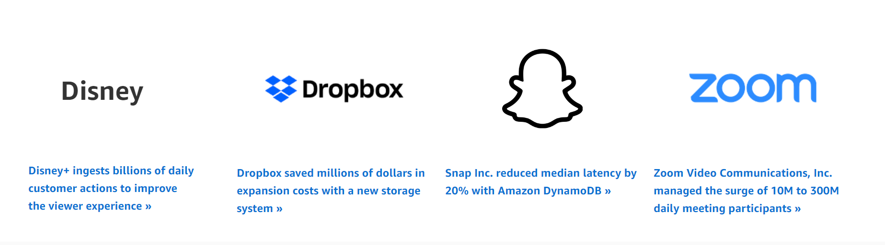
Customers
amazon. “Amazon.” Accessed September 18, 2022. https://aws.amazon.com/dynamodb/?trk=94bf4df1-96e1-4046-a020-b07a2be0d712&sc_channel=ps&s_kwcid=AL!4422!3!610000101513!e!!g!!dynamodb&ef_id=CjwKCAjwg5uZBhATEiwAhhRLHqPtUNDSySSNQD6ctcznaNsCjLMv1cPeLrdQ8vwNU2KHoIIgtJoUThoCEWkQAvD_BwE:G:s&s_kwcid=AL!4422!3!610000101513!e!!g!!dynamodb.

Slide 12
Section 1 Data Types in DynamoDB

Slide 13
Valid DynamoDB types
Python Type | DynamoDB Type
string | String (S)
integer | Number (N)
decimal.Decimal | Number (N)
boto3.dynamodb.types.Binary | Binary (B)
boolean | Boolean (BOOL)
None | Null (NULL)
string set | String Set (SS)
integer set | Number Set (NS)
decimal.Decimal set | Number Set (NS)
boto3.dynamodb.types.Binary set | Binary Set (BS)
list | List (L)
dict | Map (M)
boto3. “Valid DynamoDB Types¶.” Accessed September 18, 2022. https://boto3.amazonaws.com/v1/documentation/api/latest/reference/customizations/dynamodb.html.

Slide 14
Keys in DynamoDB

Slide 15
Partition keys
What is a partition key?
DynamoDB supports two types of primary keys:
Partition key: A simple primary key, composed of one attribute known as the partition key. Attributes in DynamoDB are similar in many ways to fields or columns in other database systems.
Partition key and sort key: Referred to as a composite primary key, this type of key is composed of two attributes. The first attribute is the partition key, and the second attribute is the sort key. All data under a partition key is sorted by the sort key value.
“Choosing the Right DynamoDB Partition Key.” Accessed September 18, 2022. https://aws.amazon.com/blogs/database/choosing-the-right-dynamodb-partition-key/.

Slide 16
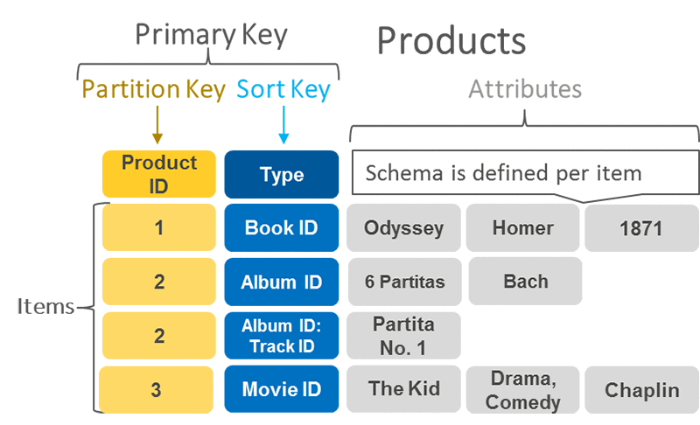
Items in DynamoDB
DynamoDB stores data as groups of attributes, known as items.
Items are similar to rows or records in other database systems.
DynamoDB stores and retrieves each item based on the primary key value, which must be unique
“Choosing the Right DynamoDB Partition Key.” Accessed September 18, 2022. https://aws.amazon.com/blogs/database/choosing-the-right-dynamodb-partition-key/.

Slide 17
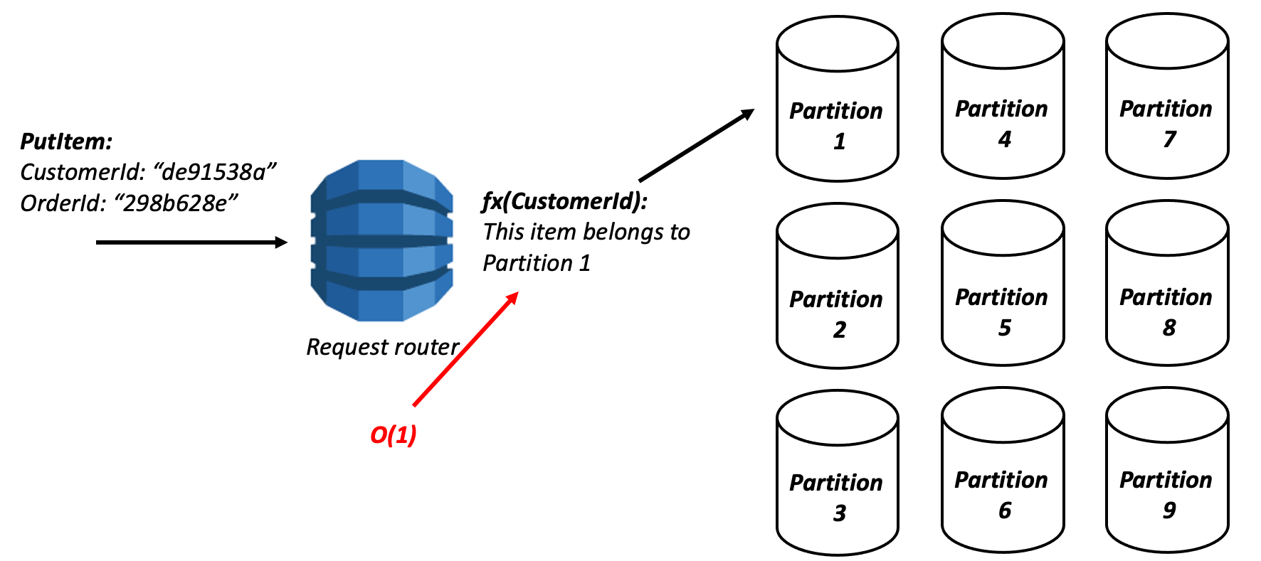
Partition keys
Items are distributed across 10-GB storage units, called partitions (physical storage internal to DynamoDB).
DynamoDB uses the partition key’s value as an input to an internal hash function.
The output from the hash function determines the partition in which the item is stored. Each item’s location is determined by the hash value of its partition key.
amazon. “Partitions and Data Distribution.” Accessed September 18, 2022. https://docs.aws.amazon.com/amazondynamodb/latest/developerguide/HowItWorks.Partitions.html.
“Choosing the Right DynamoDB Partition Key.” Accessed September 18, 2022. https://aws.amazon.com/blogs/database/choosing-the-right-dynamodb-partition-key/.

Slide 18
Partition Key
Composite Key
Partition
Partition

Slide 19
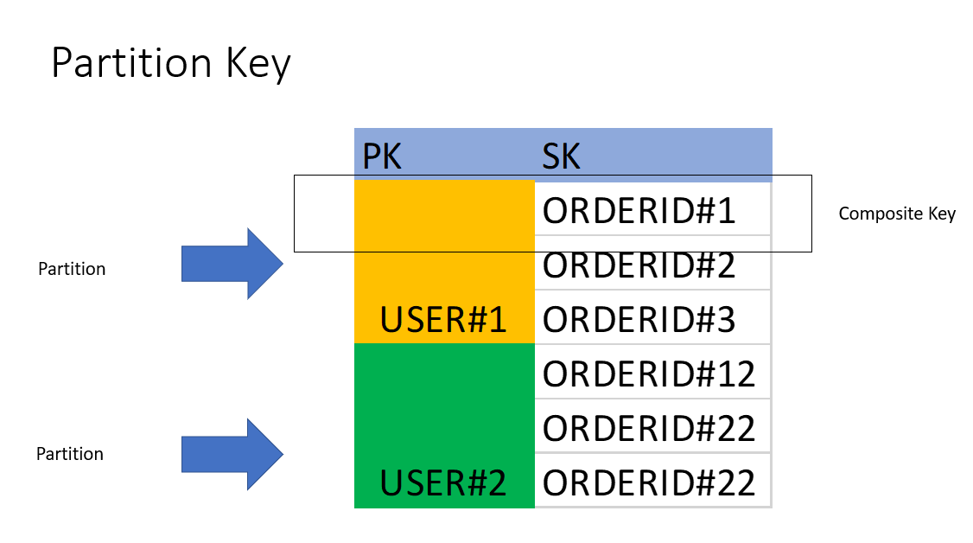
How to Query Composite Key
Use Operator like = , <=, >= , begin With

Slide 20

Item Size
Item size. The maximum item size in DynamoDB is 400 KB, which includes both attribute name binary length (UTF-8 length) and attribute value lengths (again binary length). The attribute name counts towards the size limit.

Slide 21
Recommendations for partition keys

Slide 22
Recommendations for partition keys
Use high-cardinality attributes. These are attributes that have distinct values for each item, like emailid, employee_no, customerid, sessionid, orderid, and so on.
“Choosing the Right DynamoDB Partition Key.” Accessed September 18, 2022. https://aws.amazon.com/blogs/database/choosing-the-right-dynamodb-partition-key/.

Slide 23
Recommendations for partition keys
Cache the popular items when there is a high volume of read traffic using Amazon DynamoDB Accelerator (DAX). The cache acts as a low-pass filter, preventing reads of unusually popular items from swamping partitions.
“Choosing the Right DynamoDB Partition Key.” Accessed September 18, 2022. https://aws.amazon.com/blogs/database/choosing-the-right-dynamodb-partition-key/.

Slide 24
Recommendations for partition keys
Add random numbers or digits from a predetermined range for write-heavy use cases
Suppose that you expect a large volume of writes for a partition key (for example, greater than 1000 1 K writes per second use an additional prefix or suffix (a fixed number from predetermined range, say 0–9) and add it to the partition key.
suffix range: ((Number of writes per second * CEILING(item size in KB, 1) ) /1000)
“Choosing the Right DynamoDB Partition Key.” Accessed September 18, 2022. https://aws.amazon.com/blogs/database/choosing-the-right-dynamodb-partition-key/.

Slide 25
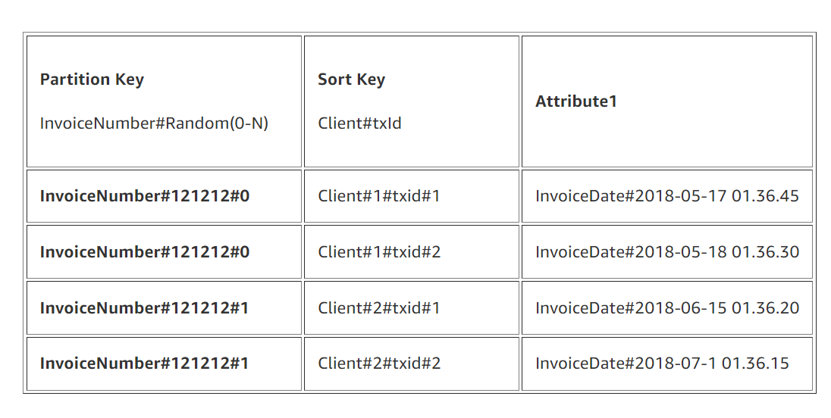
Recommendations for partition keys
For example, assume that a single InvoiceNumber contains up to 50,000 1K items and that you expect 5000 writes per second. I
n this case, you can use the following formula to estimate the suffix range: ((Number of writes per second * CEILING(item size in KB, 1) ) /1000).
Using this formula requires a minimum of five partitions to distribute writes, and hence you might want to set the range as 0-4.
“Choosing the Right DynamoDB Partition Key.” Accessed September 18, 2022. https://aws.amazon.com/blogs/database/choosing-the-right-dynamodb-partition-key/.

Slide 26
Recommendations for partition keys
This combination gives us a good spread through the partitions. You can use the sort key to filter for a specific client (for example, where InvoiceNumber=InvoiceNumber#121212#1 and Client#txId begins with Client#1).
Because we have a random number appended to our partition key (0–4), we need to query the table five times for a given InvoiceNumber.
Our partition key could be InvoiceNumber#121212#[0-4],
so we need to query where partition key is InvoiceNumber#121212#0 and Client#txId begins_with Client#1. We need to repeat this for 121212#1, on up to 121212#4 and then merge the results
“Choosing the Right DynamoDB Partition Key.” Accessed September 18, 2022. https://aws.amazon.com/blogs/database/choosing-the-right-dynamodb-partition-key/.

Slide 27
Recommendations for partition keys
Note: Note: After the suffix range is decided, there is no easy way to further spread the data because suffix modifications also require application-level changes.
As mentioned in the DynamoDB documentation, a randomizing strategy can greatly improve write throughput. But it’s difficult to read a specific item because you don’t know which suffix value was used when writing the item. To make it easier to read individual items, consider sharding by using calculated suffixes, as explained in Using Write Sharding to Distribute Workloads Evenly
“Choosing the Right DynamoDB Partition Key.” Accessed September 18, 2022. https://aws.amazon.com/blogs/database/choosing-the-right-dynamodb-partition-key/.

Slide 28
Using write sharding to distribute workloads evenly
A randomizing strategy can greatly improve write throughput. But it's difficult to read a specific item because you don't know which suffix value was used when writing the item. To make it easier to read individual items, you can use a different strategy. Instead of using a random number to distribute the items among partitions, use a number that you can calculate based upon something that you want to query on.
“Choosing the Right DynamoDB Partition Key.” Accessed September 18, 2022. https://aws.amazon.com/blogs/database/choosing-the-right-dynamodb-partition-key/.

Slide 29
Consistency Model

Slide 30
Consistency Model
Amazon DynamoDB lets you specify the desired consistency characteristics for each read request within an application. You can specify whether a read is eventually consistent or strongly consistent.

Slide 31
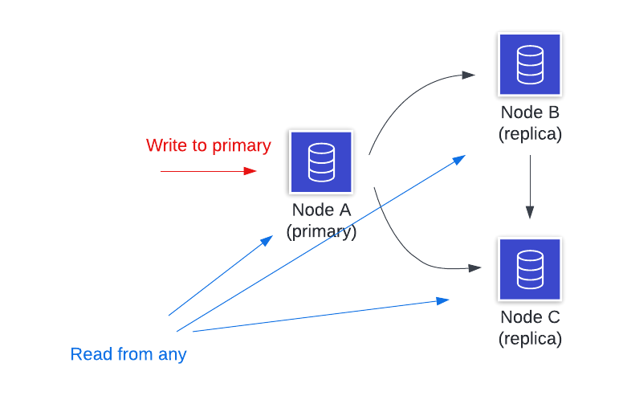
Eventually consistent
The eventual consistency option is the default in Amazon DynamoDB and maximizes the read throughput.
However, an eventually consistent read might not always reflect the results of a recently completed write. Consistency across all copies of data is usually reached within a second.
AlexDebrie. “How to Model One-to-Many Relationships in DynamoDB.” Accessed May 20, 2022. https://www.alexdebrie.com/posts/dynamodb-one-to-many/.

Slide 32
Eventually consistent Pros and Cons
PROS
The eventual consistency model always returns data with low latency.
This model prioritizes availability over consistency.
CONS
The downside of the eventual consistency model is that it may return stale data.
Again, the implementation of the application will be complex with eventual consistency since it makes the debugging process hard.

Slide 33
Strongly consistent
A strongly consistent read in Amazon DynamoDB returns a result that reflects all writes that received a successful response prior to the read.
To get a strongly consistent read result, you can specify optional parameters in a request. It takes more resources to process a strongly consistent read than an eventually consistent read.

Slide 34
Strongly consistent Pros and Cons
PROS
Gives the guarantee as it will return the most updated data.
This model prioritizes availability over consistency.
CONS
For example, some operations may fail if an insufficient number of object replicas are available.
Also, a strongly consistent read might not be available if there is a network delay or outage. In this case, DynamoDB may return a server error (HTTP 500)
Using more throughput capacity than eventually consistent reads

Slide 35
GSI and LSI

Slide 36
Scaling in DynamoDB

Slide 37
Scaling Options
On Demand Mode
Provisional capacity

Slide 38
On Demand Mode
ON Demand mode is also called as auto scaling mode where you don’t need to worry about usage dynamodb will scale resources RCUS and WCU automatically based on load
Usually Good for Newe application or when traffic is Bursty in nature

Slide 39
Provisional capacity
In this mode users specifies WCU and RCU
Write capacity unit (WCU): Each API call to write data to your table is a write request. For items up to 1 KB in size, one WCU can perform one standard write request per second. Items larger than 1 KB require additional WCUs.
Read capacity unit (RCU): Each API call to read data from your table is a read request. Read requests can be strongly consistent, eventually consistent, or transactional. For items up to 4 KB in size, one RCU can perform one strongly consistent read request per second. Items larger than 4 KB require additional RCUs.

Slide 40
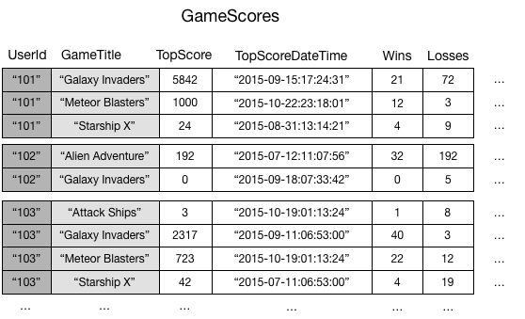
Global Secondary Index
To illustrate, consider a table named GameScores that tracks users and scores for a mobile gaming application. Each item in GameScores is identified by a partition key (UserId) and a sort key (GameTitle)
amazon. “Using Global Secondary Indexes in DynamoDB.” Accessed September 20, 2022. https://docs.aws.amazon.com/amazondynamodb/latest/developerguide/GSI.html.

Slide 41
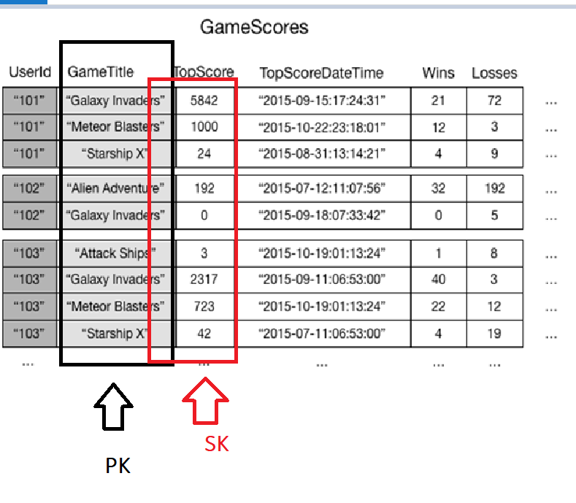
What IF you want to implement Leader board
suppose that you wanted to write a leaderboard application to display top scores for each game.
if the application needed to retrieve data from GameScores based on GameTitle only, it would need to use a Scan operation. As more items are added to the table, scans of all the data would become slow and inefficient
GSI helps you to have different PK and SK
amazon. “Using Global Secondary Indexes in DynamoDB.” Accessed September 20, 2022. https://docs.aws.amazon.com/amazondynamodb/latest/developerguide/GSI.html.

Slide 42
GSI
GSI Helps you to set a different Partition key and have different SORT key so you can query the data more efficiently rather than SCAN operations
Each table in DynamoDB can have up to 20 global secondary indexes (default quota) and 5 local secondary indexes.
amazon. “Using Global Secondary Indexes in DynamoDB.” Accessed September 20, 2022. https://docs.aws.amazon.com/amazondynamodb/latest/developerguide/GSI.html.

Slide 43
LSI

Slide 44
LSI
Some applications only need to query data using the base table's primary key. However, there might be situations where an alternative sort key would be helpful. To give your application a choice of sort keys, you can create one or more local secondary indexes on an Amazon DynamoDB table and issue Query or Scan requests against these indexes.
amazon. “Local Secondary Indexes.” Accessed September 20, 2022. https://docs.aws.amazon.com/amazondynamodb/latest/developerguide/LSI.html.

Slide 45
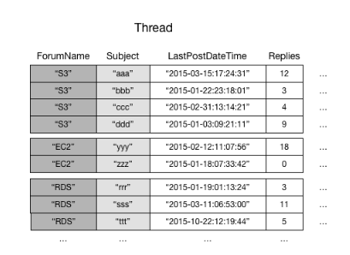
Example
This table Forum Name is PK and subject is SK
I get get data in format
Give me all items for a forum name
Give me Item where subject is ABCD
Say I want to get the data based on date range ?
Well SCAN would be To Slow and expensive So what do I do ?
amazon. “Local Secondary Indexes.” Accessed September 20, 2022. https://docs.aws.amazon.com/amazondynamodb/latest/developerguide/LSI.html.

Slide 46
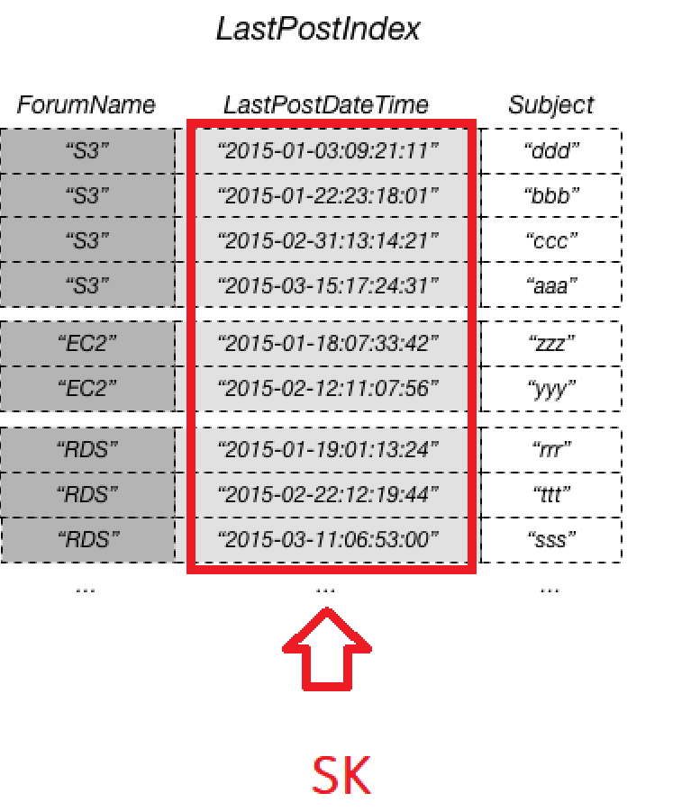
LSI
LSI helps you to have different SORT key having same PK
Now I can query data in following ways
Give me all items for a forum name
Give me Item where subject is ABCD
Give me Items for Forum for Date 2022-01
amazon. “Local Secondary Indexes.” Accessed September 20, 2022. https://docs.aws.amazon.com/amazondynamodb/latest/developerguide/LSI.html.

Slide 47
Refresh Memory
GSI | LSI
MAX 20 GSI per table | Max 5 LSI
Lets you have different PK and SK | Lets you have same PK but different SK
For tables with local secondary indexes, there is a 10 GB size limit per partition key value. A table with local secondary indexes can store any number of items, as long as the total size for any one partition key value does not exceed 10 GB
amazon. “Local Secondary Indexes.” Accessed September 20, 2022. https://docs.aws.amazon.com/amazondynamodb/latest/developerguide/LSI.html.

Slide 48
Small Exercise to Model Data in DynamoDB

Slide 49
Modelling one to many
Alex Says Discuss five different strategies for modeling one-to-many relationships in DynamoDB they are as follow
Denormalization by using a complex attribute
Denormalization by duplicating data
Composite primary key + the Query API action
Secondary index + the Query API action
Composite sort keys with hierarchical data
Read More : https://www.alexdebrie.com/posts/dynamodb-one-to-many/

Slide 50
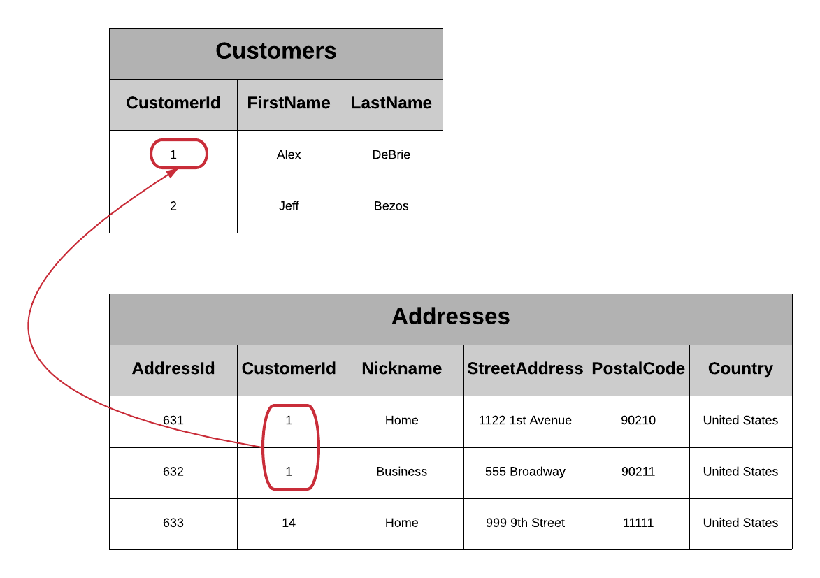
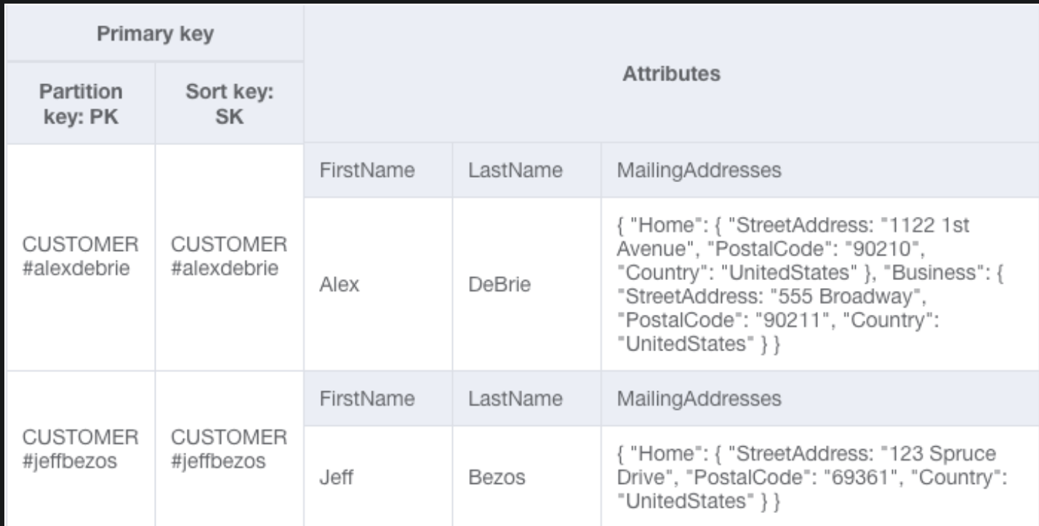
Denormalization by using a complex attribute
Example Customer can have multiple address
AlexDebrie. “How to Model One-to-Many Relationships in DynamoDB.” Accessed May 20, 2022. https://www.alexdebrie.com/posts/dynamodb-one-to-many/.

Slide 51
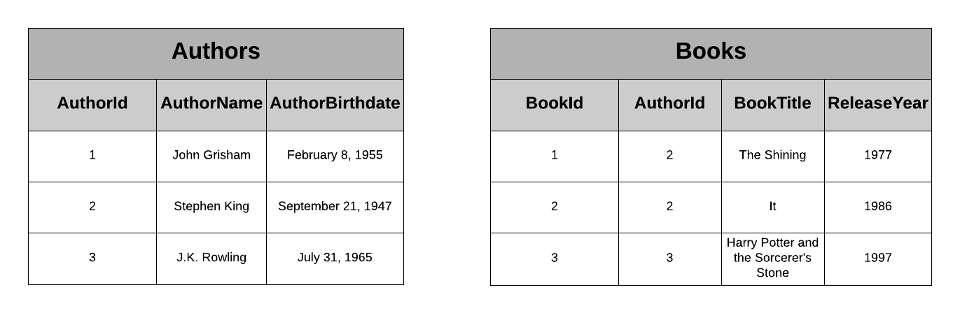
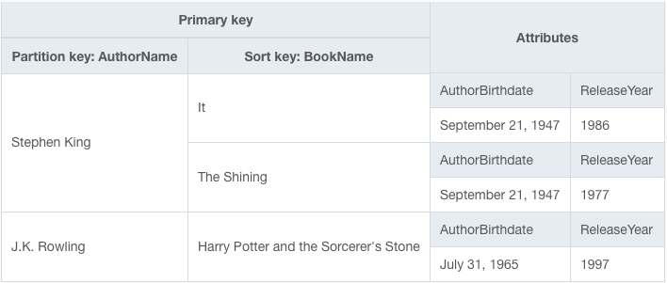
Denormalization by duplicating data
AlexDebrie. “How to Model One-to-Many Relationships in DynamoDB.” Accessed May 20, 2022. https://www.alexdebrie.com/posts/dynamodb-one-to-many/.

Slide 52
Data modelling Labs

Slide 53
Labs to Try out

Slide 54
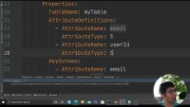
Lab 1:
Creating DynamoDB tables through serverless framework and learn to query Data using PK and SK and learn how to use GSI and LSI to query the data
Labs with code and video Click on link
Serverless Framework Lab 10: Creating dynamoDB tables - YouTube

Slide 55
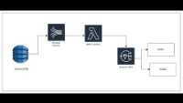
Lab 2:
Learning about DynamoDB Streams
Goal of Labs Learn how to power down stream uses to DynamoDB Streams.
Video:
Labs with code and video Click on link
Powering DownStream Users from DynamoDB Streams | FAN out Model Via Kinesis | Lab 25 with Code | - YouTube

Slide 56
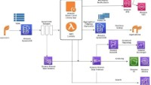
Lab 3:
Learning about DynamoDB Streams
Goal of Labs : Data Arching from DynamoDB using Kinesis Streams and Lambdas
Labs with code and video Click on link
Populate Datalake (S3) Real Time from DynamoDB with Streams | Infrasture Code| Data Archive Project - YouTube

Slide 57
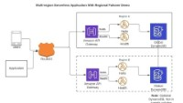
Lab 4: Multi Region Active Active Backend wit DynamoDB
Labs with code and video Click on link
From Zero to Hero in Developing and Deploying Multi-Region Active-Active Backend on AWS With Code - YouTube

Slide 58
Thank you
All references are mentioned in slides below. If I forgot to include any references, please let me know more than happy to add
This are all resources I have personally went to learn and explore the topics in details

Slide 59
References
boto3. “Valid DynamoDB Types¶.” Accessed September 18, 2022. https://boto3.amazonaws.com/v1/documentation/api/latest/reference/customizations/dynamodb.html.
amazon. “Amazon.” Accessed September 18, 2022. https://aws.amazon.com/dynamodb/?trk=94bf4df1-96e1-4046-a020-b07a2be0d712&sc_channel=ps&s_kwcid=AL!4422!3!610000101513!e!!g!!dynamodb&ef_id=CjwKCAjwg5uZBhATEiwAhhRLHqPtUNDSySSNQD6ctcznaNsCjLMv1cPeLrdQ8vwNU2KHoIIgtJoUThoCEWkQAvD_BwE:G:s&s_kwcid=AL!4422!3!610000101513!e!!g!!dynamodb.
“Choosing the Right DynamoDB Partition Key.” Accessed September 18, 2022. https://aws.amazon.com/blogs/database/choosing-the-right-dynamodb-partition-key/.

Slide 60
References
amazon. “Partitions and Data Distribution.” Accessed September 18, 2022. https://docs.aws.amazon.com/amazondynamodb/latest/developerguide/HowItWorks.Partitions.html.
amazon. “Using Global Secondary Indexes in DynamoDB.” Accessed September 20, 2022. https://docs.aws.amazon.com/amazondynamodb/latest/developerguide/GSI.html.
amazon. “Local Secondary Indexes.” Accessed September 20, 2022. https://docs.aws.amazon.com/amazondynamodb/latest/developerguide/GSI.html.

